Slide 1
L06: Classifiers

Slide 2
L06 Summary
Supervised Learning Deep Dive
Regression and Classification
More on Classification…
Machine Learning Overview
Types of ML
Classification Algorithms
Workflow + Home assignment

Slide 3
Machine Learning Overview
Using data to build models and make predictions

Slide 4
Machine Learning Overview
Machine Learning is a subset of AI that focuses on the development of computer algorithms that improve automatically through experience and use of data.
Machine learning enables computers to learn from data and make decisions or predictions without being explicitly programmed to do so.

Slide 5
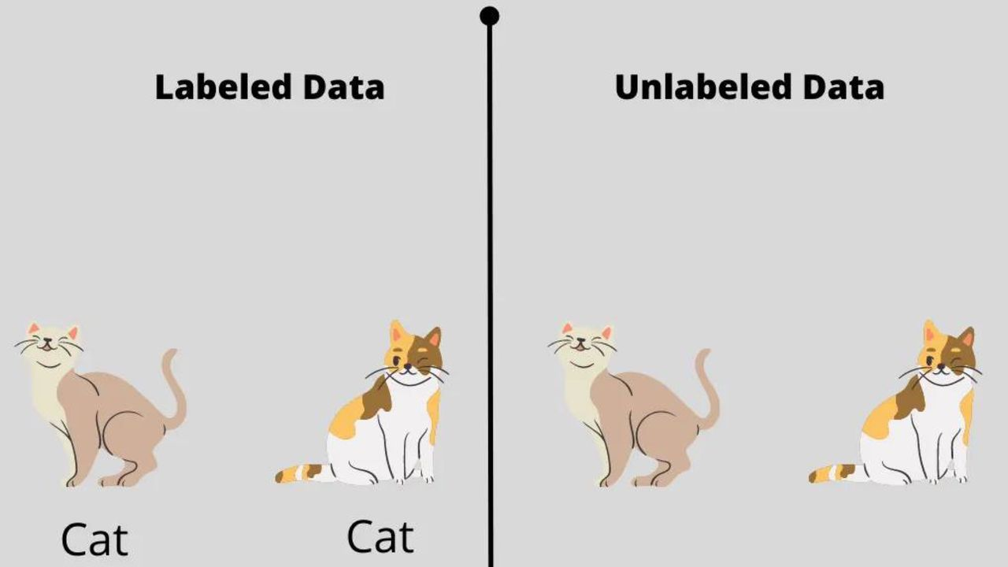
Types of Machine Learning
Supervised Learning
trained on a labeled dataset
data is accompanied by a label
Unsupervised Learning
unlabeled dataset
The model is left to find patterns and relationships in the data on its own
Reinforcement Learning
Clustering
rewards or penalties based on actions
1. Regression
2. Classification

Slide 6

Supervised Learning - Deep Dive
The algorithm learns a mapping between inputs and outputs based on labeled data.
Examples:
What does “learn” mean?
Find a function:
$$f\left(x\right)≈y$$
such that for new unseen X, it predicts y correctly.
Input (X) | Output (y)
House size | Price
Tumor Scan | Benign/malignant

Slide 7
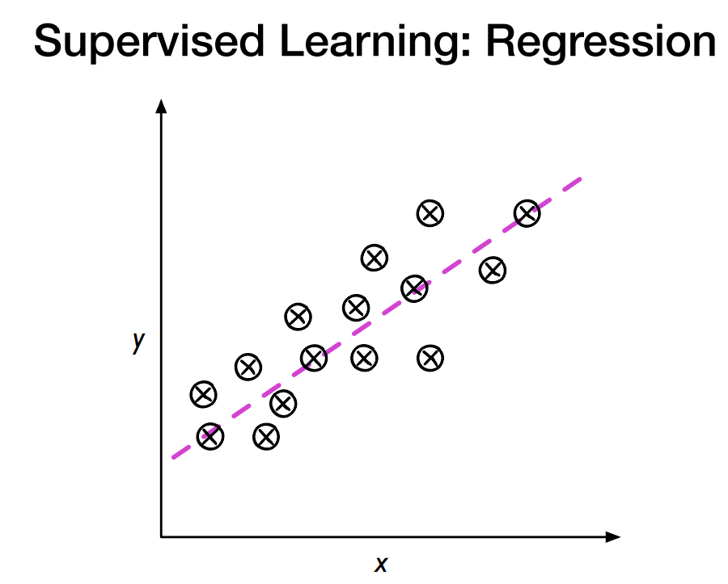
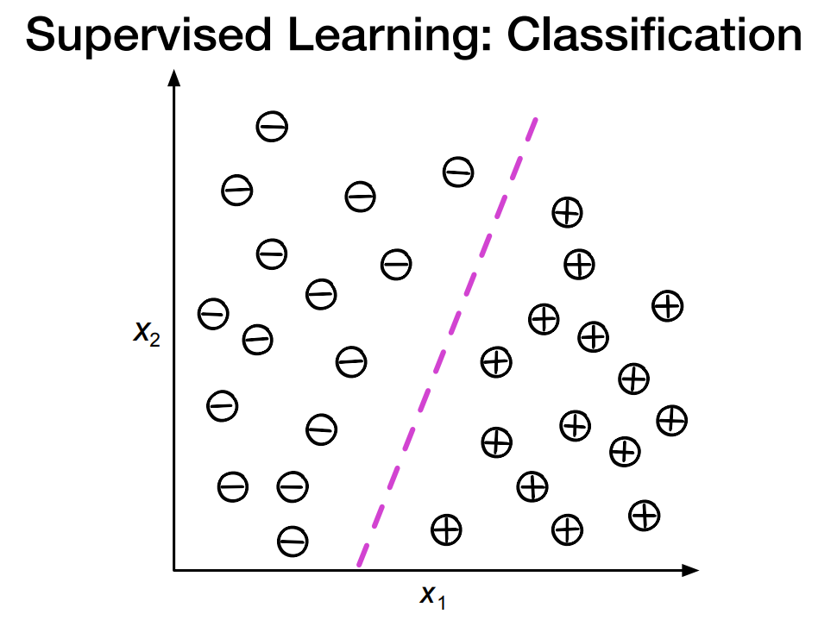
Regression vs Classification
Regression
continuous numeric value
Output: numeric
Example:
predictors: height_mother, height_father, age
output: height
Classification
category or class
Output: category/label
Example:
feature values: age, gender, income, profession
output: buyer/not buyer (label)

Slide 8
Examples of Uses
Medical diagnosis
Feature values: age, gender, history, symptom1-severity, symptom2-severity, test-result1, test-result2
Label: disease
Email spam detection
Feature values: sender-domain, length, #images, keyword1, keyword2, …, keyword n
Label: spam or not-spam
Credit card fraud detection
Feature values: user, location, item, price
Label: fraud or okay

Slide 9
1. Regression
Regression = model predicts a numeric value
The relationship between features and labels
One such algorithm is Linear Regression -> Model tries to find a line
Step 1: Plot the points
Step 2: Draw a line through the points
Step 3: Adjust the line
Input (X) House size | Output (y) Price
25 | 65,000
30 | 70,000
50 | 95,000

Slide 10

In algebraic terms, the model is:
y = mx + b
In Machine Learning:
y’ is the predicted label (the output)
b is the bias of the model (bias is a parameter calculated during training)
w1 is the weight of the feature (weight is a parameter calculated during training)
x1 is a feature (the input)
y is the value we want to predict
m is the slope of the line.
x is our input value
b is the y-intercept (where it intersects y)

Slide 11

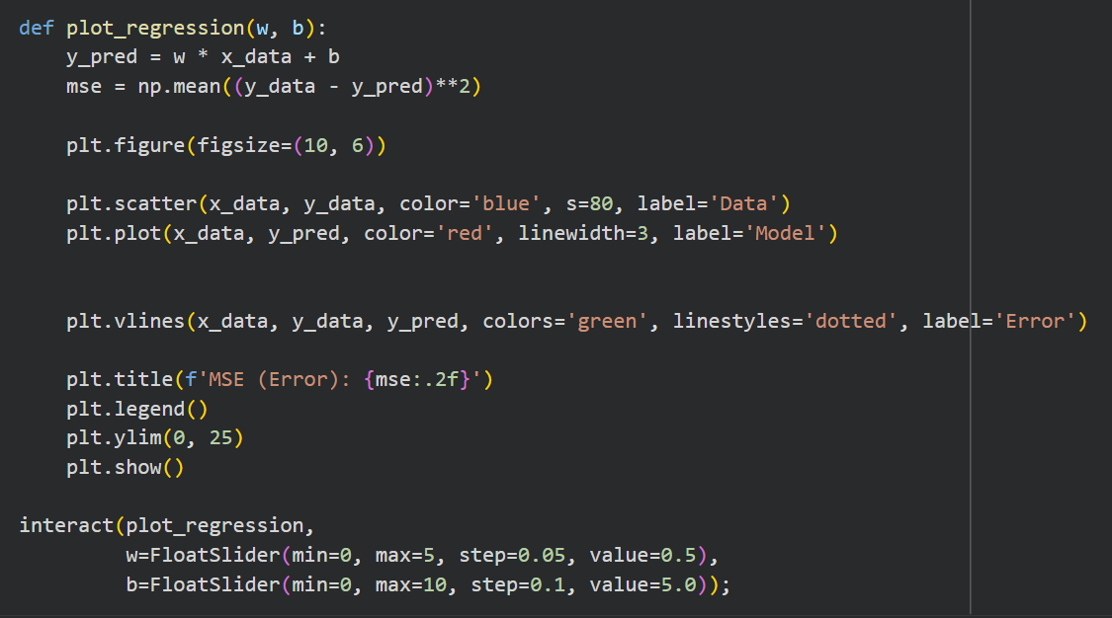
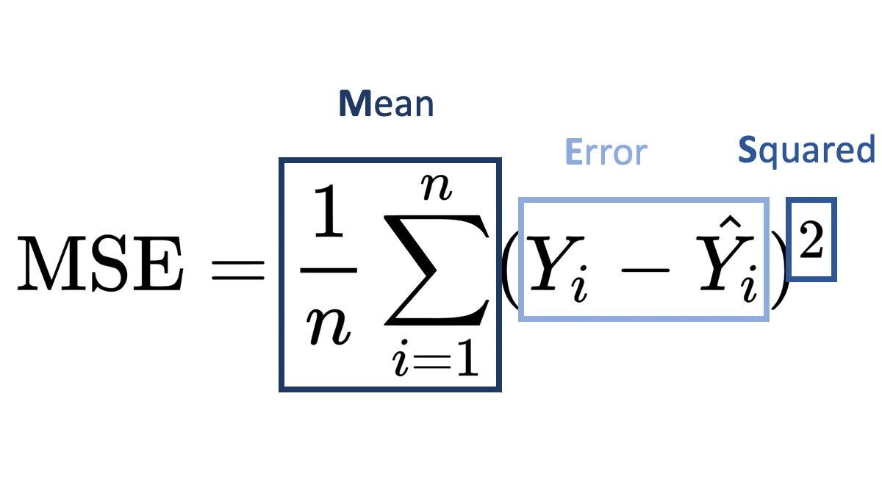
Simple Example with Linear Regression
Let’s create a small fake dataset. The goal is to let you interact with the slope (w) and intercept (b) to see how the predicted line changes and how the error (MSE) changes
import numpy as np
import matplotlib.pyplot as plt
from ipywidgets import interact, FloatSlider
Create x-values
Add noise - makes the y more realistic and not completely linear
  10 random integers between -2 and +2
Create y-values: use the noise above to create the predicted values
Define plot function to compute predicted values and Error using MSE (the lower the error the better!)

Slide 12

Loss
Loss is a numerical metric that describes how wrong a model’s predictions are.
Measures the distance between the predicted value ($\hat{y})$ and the true value ($y$).
The goal of training a model is to minimize the loss, reducing it to its lowest possible value.
Choosing the error measurement depends on your dataset, algorithm and use case
Algorithm | Task | The Default Loss Function | Why?
Linear Regression | Regression (Numbers) | Mean Squared Error (MSE) | We care about the distance from the line.
Logistic Regression | Classification (Probabilities) | Cross-Entropy (Log Loss) | We care about the probability of being right.
SVM | Classification (Hard Classes) | Hinge Loss | We care about the margin (width) of the boundary.
Neural Networks | Flexible | Depends on the output | Uses MSE for regression tasks, Cross-Entropy for classification tasks.

Slide 13

Models with multiple features
Models can rely on multiple features for predictions!
x1 = house size
x2 = year built
x3 = number of rooms
X4 = etc…
price= b + w1​(size) + w2​(year) + w3​(rooms)
Each feature contributes to the prediction with a different weight:
size might be more important => larger influence on y
year might matter less
number of rooms somewhere in between
The model learns how important each feature is.

Slide 14
Question
What parts of the linear regression equation are updated during training?
The bias and weights
The feature values
The prediction

Slide 15
2. Classification
The model learns to assign a categorical label to input data.
Predicting which of a set of classes (categories) an example belongs to.
Given an input X → predict the correct class y
Binary classification (cancer vs healthy)
Multiple classification (handwritten digits (0–9))
Instead of predicting a value (like price in regression), we predict a category

Slide 16
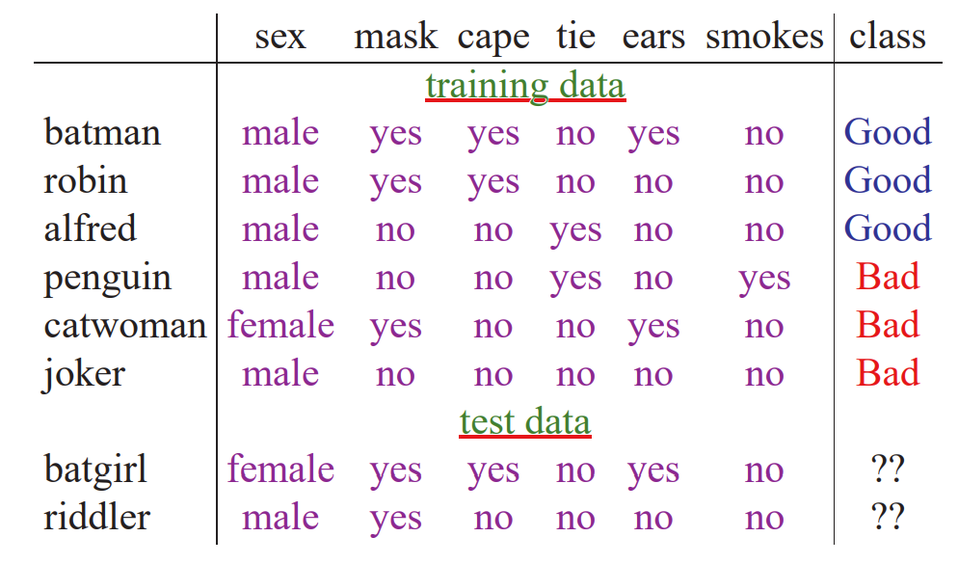
Example

Slide 17
Types of Classifiers
Linear: models create a linear decision boundary between classes. They are simple and computationally efficient.
Non-linear: create a non-linear decision boundary between classes. They can capture more complex relationships between input features and target variable.

Slide 18
Workflow
Load dataset: We start with a dataset where each item is labeled with the correct class.
Clean and Preprocess the dataset + Fill in Missing Values
Encode Categories
Train/Test Split
Scale Data
Train the models
Evaluate: key step in machine learning. It helps us check how well the model performs and how good it is at handling new, unseen data.

Slide 19
Classification Algorithms
Logistic Regression
Decision Tree
K-Nearest Neighbor
Random Forest
Naive Bayes
And others...
Many of these algorithms can be easily implemented in Python using scikit-learn libraries

Slide 20
Dataset - Titanic
The Titanic dataset is like “Hello World” in machine learning
Kaggle provides a CSV file with real Titanic passenger data
Task: Build a model that can answer the question “What sorts of people were more likely to survive the Titanic?” using passenger data (ie name, age, gender, socio-economic class, etc).
=> Binary Classification of survival

Slide 21
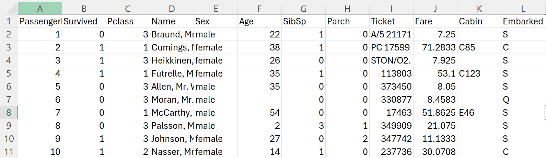
Dataset - Titanic
Column | Meaning
Survived | 0 = died, 1 = survived
Pclass | Ticket class (1, 2, 3)
Name | Passenger name
Sex | male/female
Age | Age in years
SibSp | Siblings/spouses aboard
Parch | Parents/children aboard
Ticket | Ticket number
Fare | Ticket price
Cabin | Cabin number (many missing)
Embarked | Port: C, Q, S
Observations:
Requires cleaning
Real-world messy categories
Many missing values
Many features

Slide 22


Step 1. Load the dataset
Go into Google Colab: https://colab.research.google.com/drive/1183CVnBi3sX3_fx_teTRozXsVqvtty1c?usp=sharing
Upload the csv file
Let’s look at the first 5 rows…

Slide 23
Step 2. Clean the Dataset and Select the Important Features
We keep only the columns we need for the model:
Survived (target variable)
Pclass, Sex, Age, Embarked (features)
Removing unnecessary columns makes the model simpler and easier to train.
This is part of feature selection.

Slide 24

Step 3. Fill in Missing Values
Real-world datasets often have missing data.
For Age:
We replace missing values with the median age (robust to outliers).
For Embarked:
We replace missing values with the most frequent category (mode).
This prevents errors during training and keeps all rows usable.

Slide 25

Step 4. Encode Categories (from text to numbers)
Machine learning models work with numbers, not text.
We map:
Sex: “male” = 0, “female” = 1
Embarked: “S” = 0, “C” = 1, “Q” = 2
This is called encoding categorical variables.
After this step, all features are numeric.

Slide 26

Step 5: Set X and y
Here we define the features (X) and labels (y)
This is the standard ML notation:
X => input
y => output
X = all columns except Survived - the input features.
y = Survived column - the target we want to predict.

Slide 27
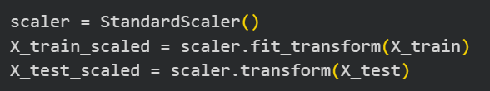
Step 6. Train/Test Split
controls the randomness of the data splitting
We split the data into:
80% training data (X_train, y_train)
20% testing data (X_test, y_test)
From The Hitchhiker's Guide to the Galaxy by Douglas Adams. - a supercomputer calculates the "Answer to the Ultimate Question of Life, the Universe, and Everything" for 7.5 million years, and the answer turns out to be... 42.
The Titanic was traveling at a speed of 42 km/hour when it collided with the iceberg
On page 42 of Harry Potter and the Philosopher’s Stone, Harry finds out he is a wizard
42 is the angle rounded to whole degrees for which a rainbow appears (the critical angle)
Step 7. Scale the data (for some models)
Some models (Logistic Regression, SVM, KNN) are sensitive to the scale of features.
StandardScaler transforms each feature to have:
mean = 0
standard deviation = 1
This helps the algorithms converge faster and perform better.

Slide 28
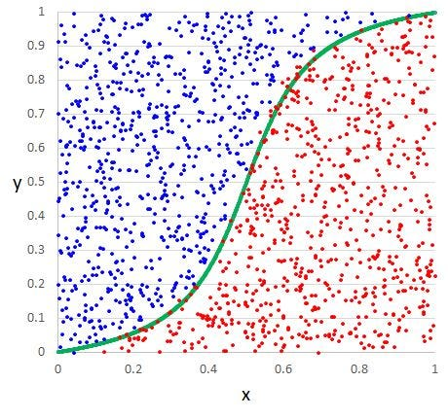
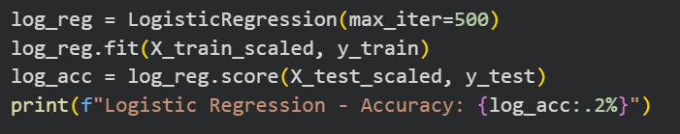
1. Logistic Regression
Linear
Simple and fast
Great baseline
Good for linearly separable data

Slide 29
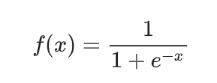
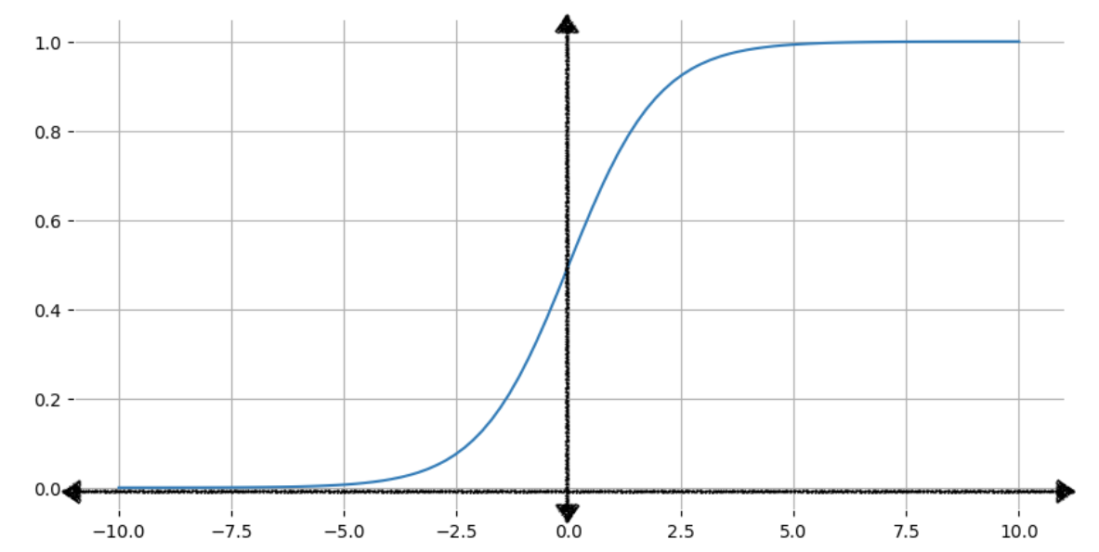

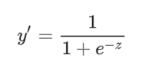
1. Logistic Regression
Predicting the probability of a given outcome
Sigmoid function (value between 0 and 1)
f(x) is the output of the sigmoid function.
x is the input to the sigmoid function
To obtain the logistic regression prediction,
the z value is then passed to the sigmoid function
OUTPUT: a probability between 0 and 1
As the input x increases, the output of the sigmoid function approaches but never reaches 1.
As the input decreases, the sigmoid function's output approaches but never reaches 0.

Slide 30
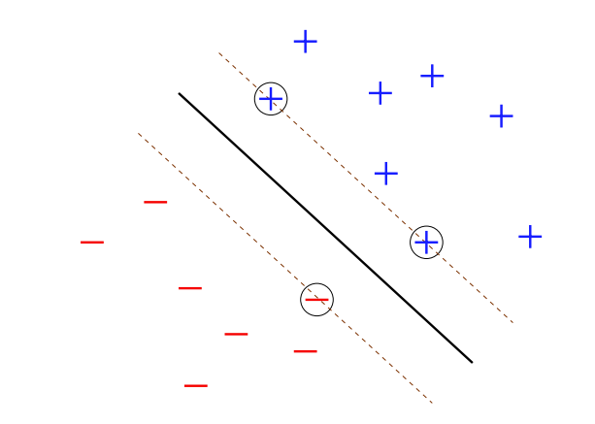
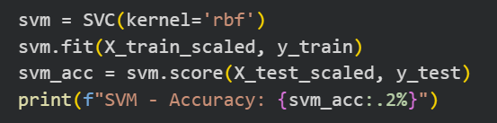
2. Support Vector Machine (SVM)
Data points into a multidimensional space
Discovers the optimal line (hyperplane/decision boundary) that best divides the data points into categories. => maximizing the space between the classes
margin = distance to separating hyperplane
Support vectors = data points sitting on the edge of the margin
Intuitively:
We want to separate +’s from −’s as much as possible
margin = measure of confidence

Slide 31
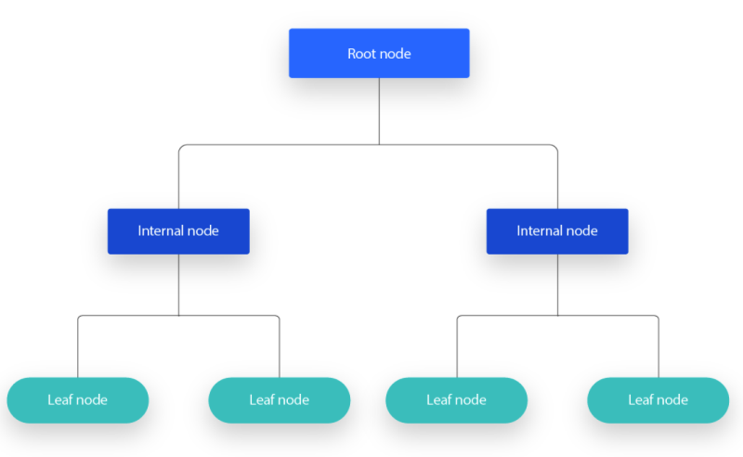
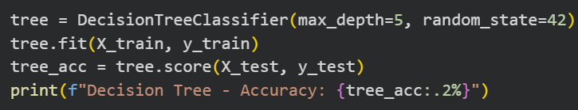
3. Decision Tree
Non-linear classifier (non-linear decision boundary)
Used for both classification and regression
continuously separates data in order to categorize
Tree-structure, splits data based on rules
Each internal node asks a yes/no question
Leaves represent final class predictions.
The tree grows until a stopping condition, like max_depth.
Use the training data to construct a decision tree
Use the decision tree to classify new data
Nodes: features
Edges: feature values
Leaves: labels
Primary challenge is building good decision trees from training data

Slide 32
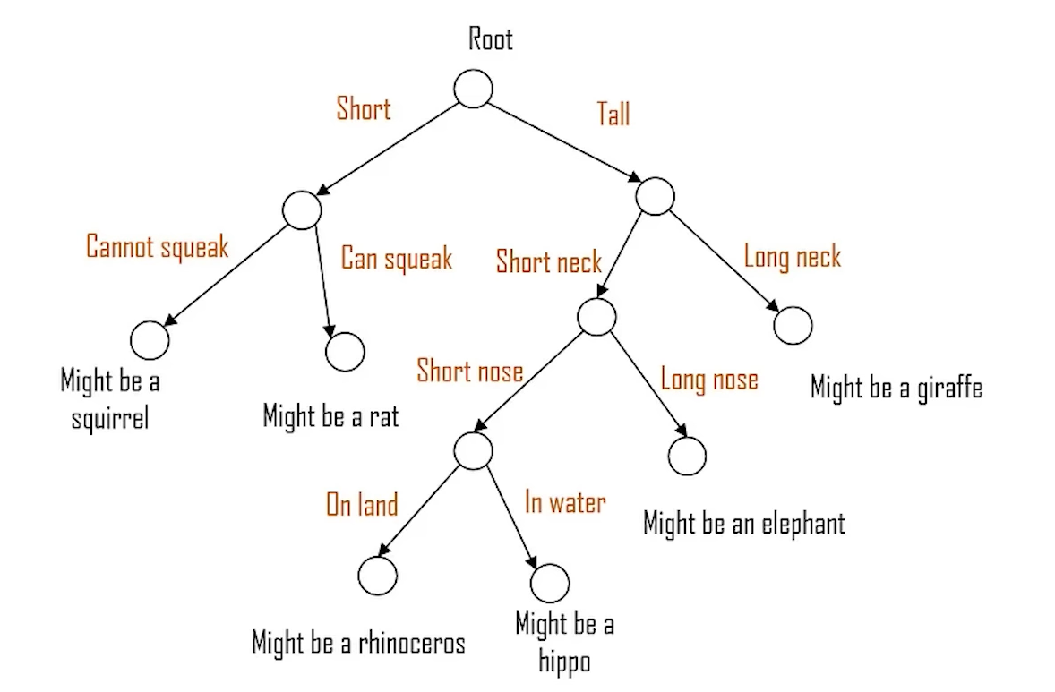
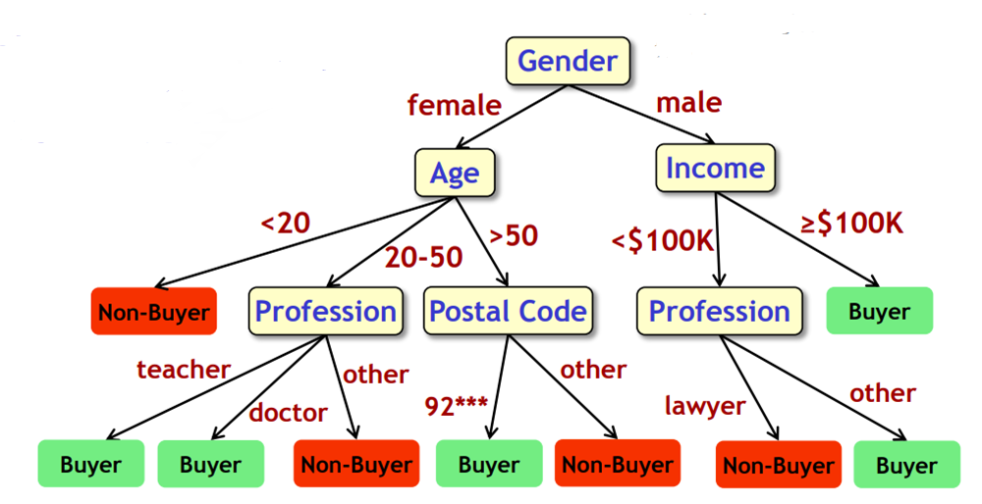
3. Decision Trees - Example
New data item to classify: Navigate tree based on feature values

Slide 33
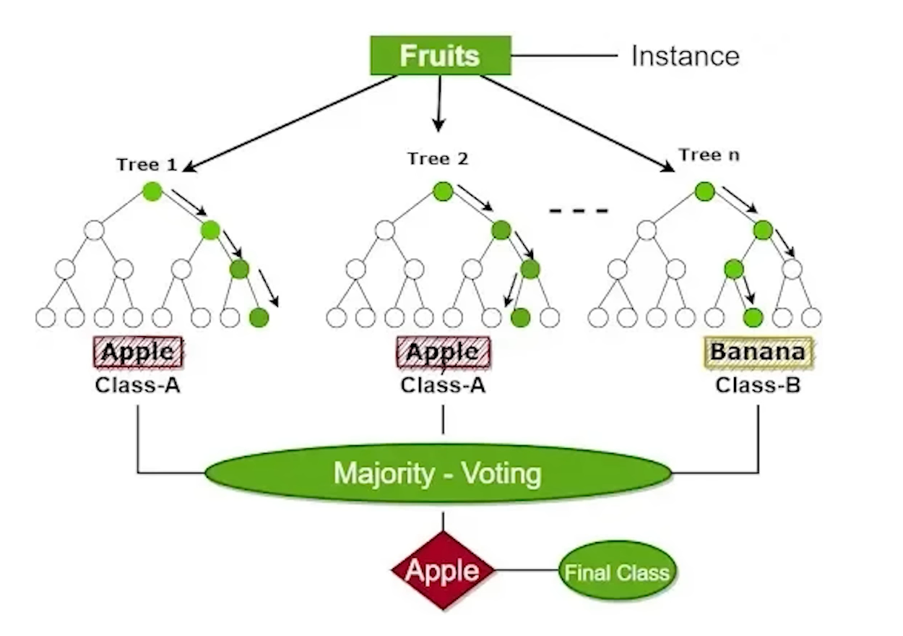
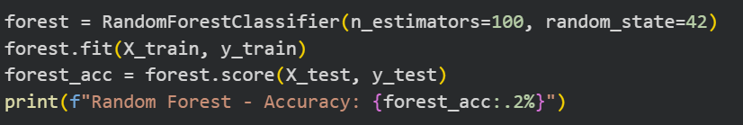
4. Random Forest
Can handle both classification and regression tasks.
An ensemble of many Decision Trees.
Each tree sees a random subset of data
At each split, each tree also sees a random subset of features.
Final prediction = majority vote of all trees.
Random forest algorithms create multiple decision trees for each task, aggregate the prediction of all the trees, then choose the most popular answer as the definitive result.

Slide 34
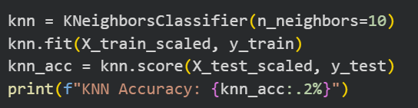
5. K-Nearest Neighbor
A non-parametric classifier (no training step).
Classifies a new sample based on the K closest neighbors in the training set.
Uses a distance metric
Sensitive to feature scaling => normalization required
When a new point arrives, KNN looks around and asks:
“Which class do most of my closest neighbors belong to?”
Pick a number K
Compute distance from the new point to all training samples.
Take the K closest samples.
See which class appears most often.
That’s the prediction

Slide 35
KNN - Example
Features - gender, profession, age, income, postal-code
person1 = (male, teacher, 47, $25K, 94305) buyer
person2 = (female, teacher, 43, $28K, 94309) non-buyer
To classify a new item i: In the labeled data find the K closest items to i, assign most frequent label
person3 = (female, doctor, 40, $40K, 95123)
For any pair of data items i1 and i2, from their feature values compute distance(i1,i2)
distance(person1, person2)
To classify a new item i: find K closest items to i in the labeled data, assign most frequent label

Slide 36
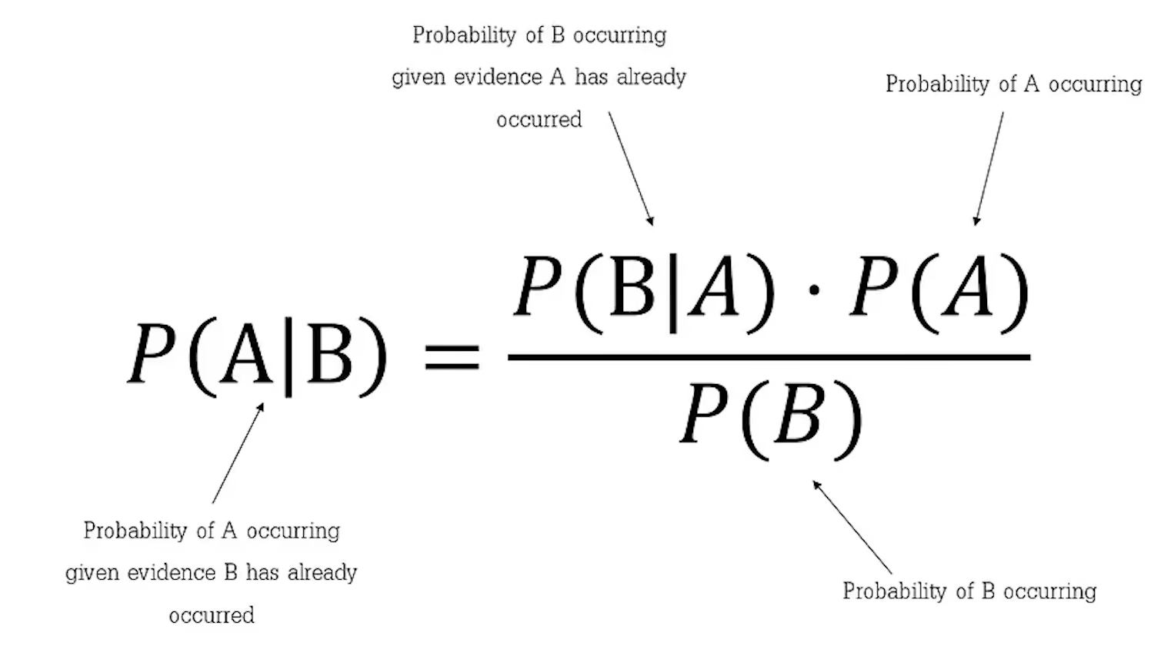
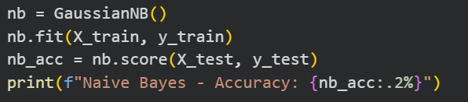
6. Naïve Bayes
probabilistic classifier based on Bayes’ Theorem
Assumes all features are independent (the “naive” assumption).
Given new data item i, based on i’s feature values and the training data, compute the probability of each possible label. Pick highest one.

Slide 37
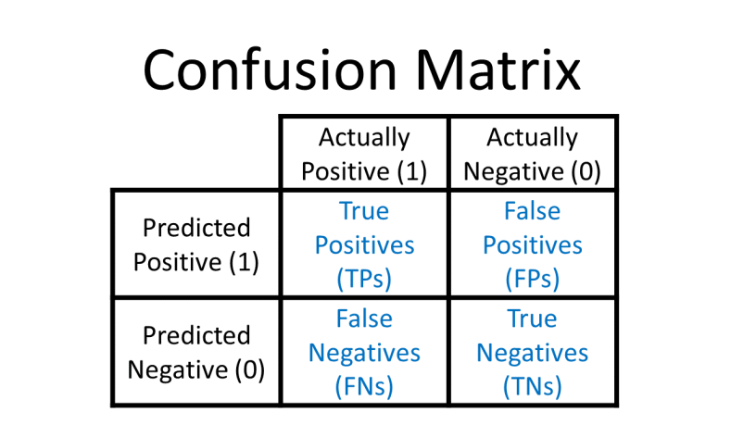
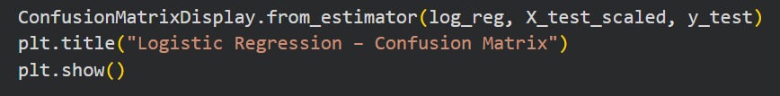
Confusion Matrix
TP: Model correctly predicts survival
TN: Model correctly predicts death
FP: Model predicts survival but passenger died
FN: Model predicts death but passenger survived (dangerous!)
Some errors are worse than others:
False Negative (predicting a survivor will die) - serious mistake
False Positive (predicting survival wrongly) - also problematic

Slide 38
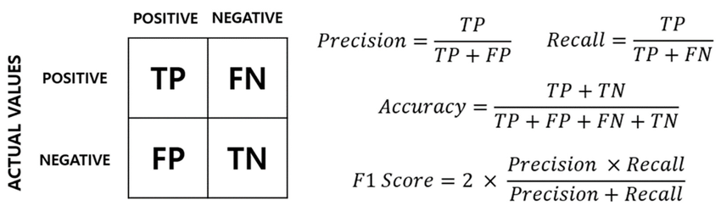
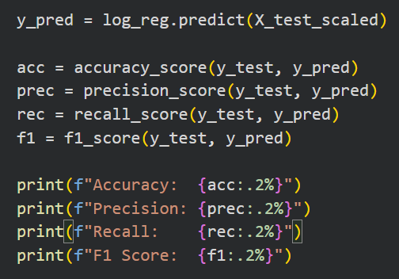
Evaluation
Accuracy = “How often is the model right?”
Precision = Of all passengers the model predicted as survivors, how many actually survived?
How often is a predicted survivor actually alive?
Recall = Of all the passengers who actually survived, how many were detected by the model?
“How many actual survivors did the model find?”
F1 Score = Balance of Precision and Recall
How good is the model overall at detecting survivors and being correct when it predicts survival?

Slide 39
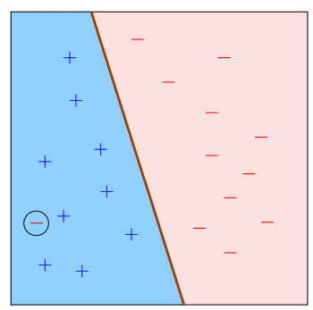
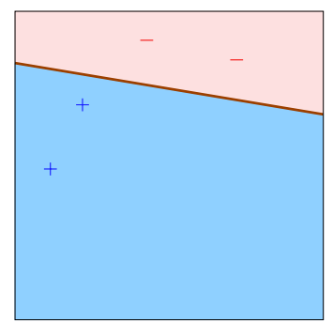
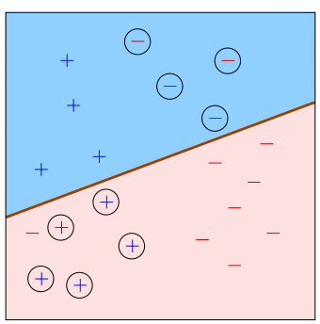
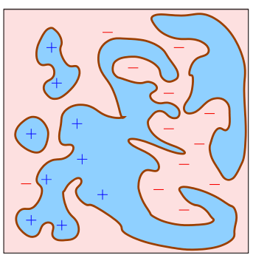
Good and Bad Classifiers
Good:
sufficient data
low training error
simple classifier
Bad:
insufficient data
High training error
Classifier too complex

Slide 40
Helpful extra steps…
Remove incorrect values from the features (null values and values that don't belong in that column).
Build a baseline model and get the accuracy on both the training and test data. If the difference in accuracy is significant then that's a sign of overfitting.
Try normalizing the data if the difference in the ranges of the columns is significant.
Not all the features in your data are useful for predictions. To fix this try feature selection techniques like RFE (Recursive Feature Elimination) to select the best features. (Applying these on highly correlated values can be efficient at times).
Rinse and Repeat, keep trying the things you know till you get the desired output. Always create multiple models to compare if you are making any progress or not.

Slide 41
What attributes of a dataset would be ideal to use for ML?
Small size / Low diversity
Small size / High diversity
Large size / Low diversity
Large size / High diversity

Slide 42
If you wanted to predict the cost of an airplane ticket, would you use regression or classification?
Regression
Classification

Slide 43
If the model's predictions are far off, what might you do to make them better?
Retrain the model but use only the features you believe have the strongest predictive power for the label.
Retrain the model using a larger and more diverse dataset.
You can't fix a model whose predictions are far off.
Try a different training approach. For example, if you used a supervised approach, try an unsupervised approach.

Slide 44
Homework
Find a dataset of your choice (CSV)
It must contain at least one categorical target (classification)
It must require some cleaning (missing values, irrelevant columns)
Clean the dataset (handle missing values, remove irrelevant columns, scale features)
Train with the classifiers
Write a report of this process and analyze the results
Send report to bianca.ebrasu@gmail.com

